Slide 1
Employee Data Analysis using Excel
STUDENT NAME:G.LATHIKA
REGISTER NO:122202439
DEPARTMENT: B.COM (CORPORATE SECRETARYSHIP)
COLLEGE : DR.MGR JANAKI COLLEGE OF ARTS AND SCIENCE FOR WOMEN

Slide 2
PROJECT TITLE
Employee Performance Analysis using Excel

Slide 3


AGENDA
Problem Statement
Project Overview
End Users
Our Solution and Proposition
Dataset Description
Modelling Approach
Results and Discussion
Conclusion
3/21/2024 Annual Review

Slide 4

PROBLEM STATEMENT
1. **Performance Measurement**: - How can we systematically measure and evaluate employee performance based on key performance indicators (KPIs) using Excel? 2. **Identify High and Low Performers**: - What methods can we use in Excel to identify high and low-performing employees based on their performance metrics? 3. **Trend Analysis**: - How can we analyze performance trends over time for individual employees or teams using Excel, and what insights can we derive from these trends?

Slide 5
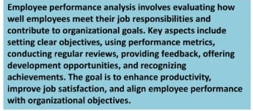

PROJECT OVERVIEW
.

Slide 6
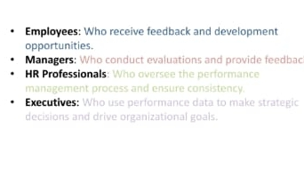

WHO ARE THE END USERS?

Slide 7

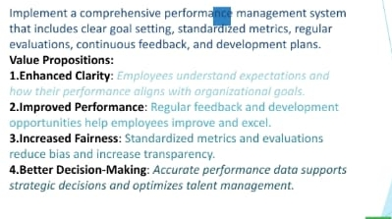
OUR SOLUTION AND ITS VALUE PROPOSITION

Slide 8
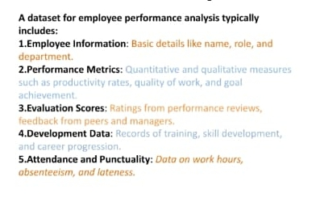
Dataset Description

Slide 9
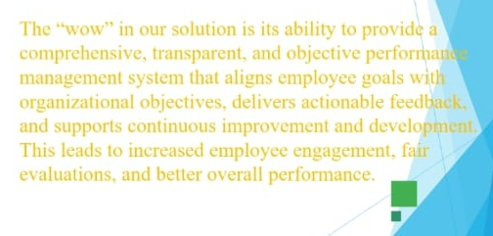

THE "WOW" IN OUR SOLUTION
3/21/2024 Annual Review
9

Slide 10
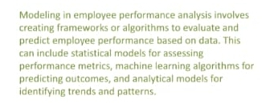
MODELLING
10

Slide 11
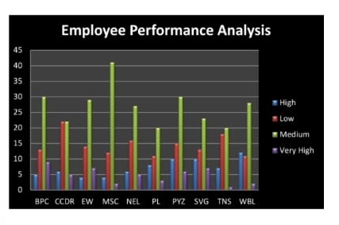
RESULTS
11

Slide 12
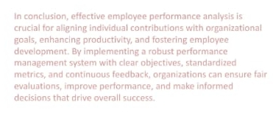
conclusion

